Slide 1

Connected Campus
Mark Girguis, Kishan Patel, Ankit Monga,
Eric Gonzalez, Jason Chung, Hector Khuon

Slide 2
Project Description | Connected Campus
Every school collects student activity through the swipes of their student ID’s. Students swipe at the dining hall, the front desk of the RAC, the residence halls, the library, labs, and so many other places. We aim to develop an authorized app that analyzes where students are visiting the most and at what times. This data could be used to make business decisions regarding when to increase staff in needed areas through alerts. This alert system could be used to minimize the broadcast messages until absolutely necessary. For example, if there’s a water fountain not working on the second floor of the RAC, only students who swipe in will get that notification. Dashboards and views will be made and HIPAA compliance will be followed.

Slide 3
The Team | Roles
Mark Girguis - Project Manager
Kishan Patel - Programmer
Ankit Monga - Data Analyst
Eric Gonzales - Business Analyst
Jason Chung - Systems Designer
Hector Khuon - Quality Assurance

Slide 4
Systems Request

Slide 5
Business Needs
Overstaffed areas with little or no traffic
Students receive alerts that are unrelated to them
LMS Engagement score not being used to alert students in need

Slide 6
Business Requirements | Goals
Web-based accessible dashboard of activity
Alerts trigger in real-time for high-traffic areas
Post alerts to organization websites and mobile app
LMS Engagement correlation to grade distributions
Permission-based, user-friendly UI

Slide 7
252,000$
284,000
0.50-1.50
Estimated Business Value
Budget savings from FTE/PTE transition
Fewer alert recipients
GPA increase of average student

Slide 8
Feasibility Analysis

Slide 9
Technical Feasibility
Familiarity
- Alert systems already used
- User-friendly UI
Project size / Distinct features
- Entire campus, approx. 15,000+
- 3 month time frame
- Location-based alerts
Compatibility
- Integration with current campus swipe data and LMS

Slide 10
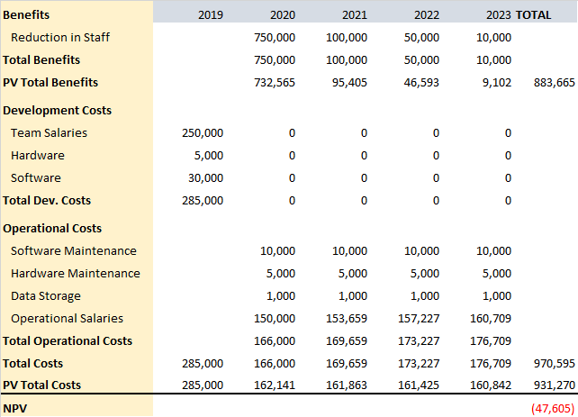
Economic Feasibility
Development Costs
- Team salaries
- Hardware and Software
- Office Space and Equipment
- Data Conversion Costs
Operational Costs
- Software Maintenance
- Storage Fees
- Ops team Salaries
Tangible Benefits
- Reduction in Staff
Intangible Benefits
- Improved Service
- Improved Decision Making
- Alert System

Slide 11
Organizational Feasibility
Strategic alignment
- Increased efficiency
- Cut costs from overstaffing
- Improve student production
Management prowess
- Allow greater control of staff
- Real-time data
- Effective alert system
Resource sufficiency
- Existing card readers already deployed
- Staff reduction eases load on overall resources

Slide 12
Our Proposed Design

Slide 13
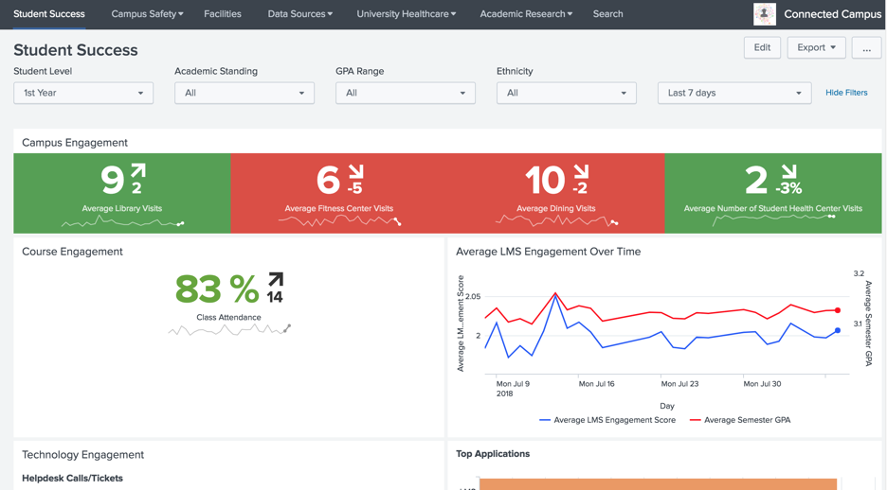

Slide 14
TRUST THE PROCESS (PADIO)
Planning
Design
February
March, April
February, March
April, May
Planning, Analysis
Implementation

Slide 15

THANKS!
Any questions?

Slide 16
References
Special thanks to:
https://researchguides.library.brocku.ca/ENTR2P91/organizational-legal

